Slide 1
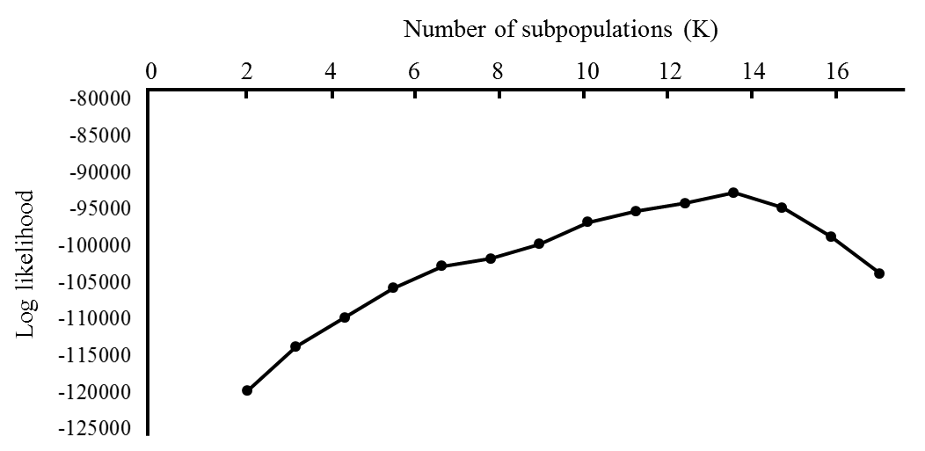
Suppl. Fig. 1.
Suppl. Fig. 1. Number of clusters, which have the highest maximum likelihood.

